Slide 1
Chapter 14 User Datagram Protocol (UDP)

Slide 2
Outline
Introduction
User datagram
UDP Services
UDP Applications
UDP package

Slide 3
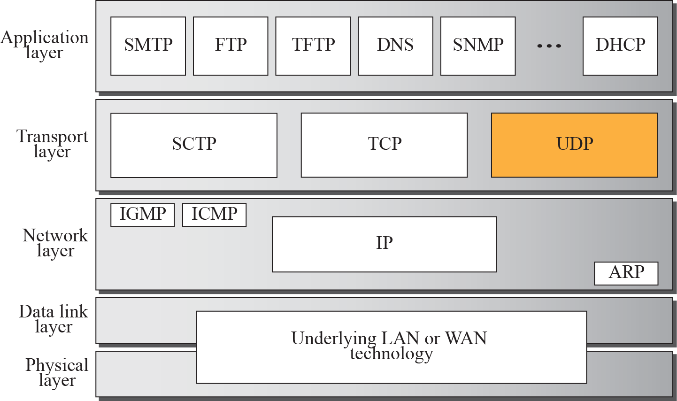
Figure 11-1
Position of UDP in the TCP/IP
Protocol Suite
The McGraw-Hill Companies, Inc., 2000

Slide 4
Introduction
A transport layer protocol usually has two responsibilities
Create a process-to-process communications
Provide control mechanism
UDP does this task at a very minimal level
It only provides error control to some extent

Slide 5
Introduction (Cont.)
UDP is a connectionless, unreliable transport protocol
Only add process-to-process communication to the IP
And perform very limited error checking
Advantages
UDP is very simple protocol using a minimum of overhead

Slide 6
Outline
Introduction
User datagram
UDP Services
UDP Applications
UDP package

Slide 7
User Datagram
UDP packets: called user datagrams
Have a fixed-size header of 8 bytes
The fields are
Source port number: 16-bits: 0~65535
Usually chosen by the UDP software
Destination port number: 16-bits: 0~65535
Total Length: 16 bits:
Header plus data of the user datagram
Minimum length must be 8 bytes (contains only header)
Checksum: 16 bits
Detect errors over the entire user datagram (header plus data)

Slide 8
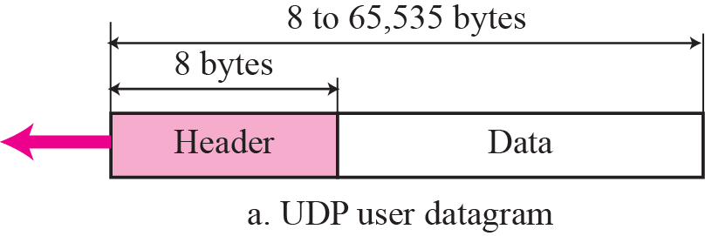
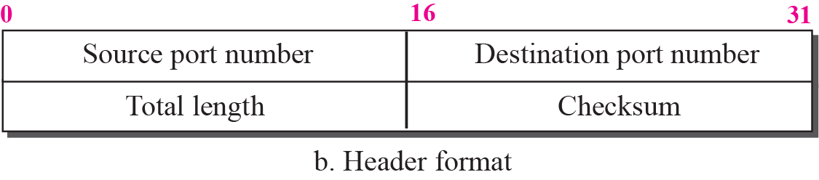
Figure 11-7
User Datagram Format
The McGraw-Hill Companies, Inc., 2000

Slide 9
User Datagram (Cont.)
However, the UDP length can also be derived from the IP header
UDP length = IP length – IP header’s length
Thus, theoretically, the length field in a UDP datagram is not necessary
However, it is more efficient to derive the length of a UDP packet by the UDP package itself
Ask the IP layer is time consuming

Slide 10
Example 14.1
The following is a dump of a UDP header in hexadecimal format.
a. What is the source port number?
b. What is the destination port number?
c. What is the total length of the user datagram?
d. What is the length of the data?
e. Is the packet directed from a client to a server or vice versa?
f. What is the client process?

Slide 11
Example 14.1 Continued
Solution
a. The source port number is the first four hexadecimal digits (CB84)₁₆ or 52100.
b. The destination port number is the second four hexadecimal digits (000D)₁₆ or 13.
c. The third four hexadecimal digits (001C)₁₆ define the length of the whole UDP packet as 28 bytes.
d. The length of the data is the length of the whole packet minus the length of the header, or 28 – 8 = 20 bytes.
e. Since the destination port number is 13 (well-known port), the packet is from the client to the server.
f. The client process is the Daytime (see Table 14.1).

Slide 12
Outline
Introduction
User datagram
UDP Services
UDP Applications
UDP package

Slide 13
UDP Services
UDP Service: services provided by UDP to the applications in upper layer, i.e., application layer
Process-to-Process Communication
Connectionless Services
Flow Control
Error Control
Congestion Control
Encapsulation and Decapsulation
Queuing
Multiplexing and Demutiplexing

Slide 14
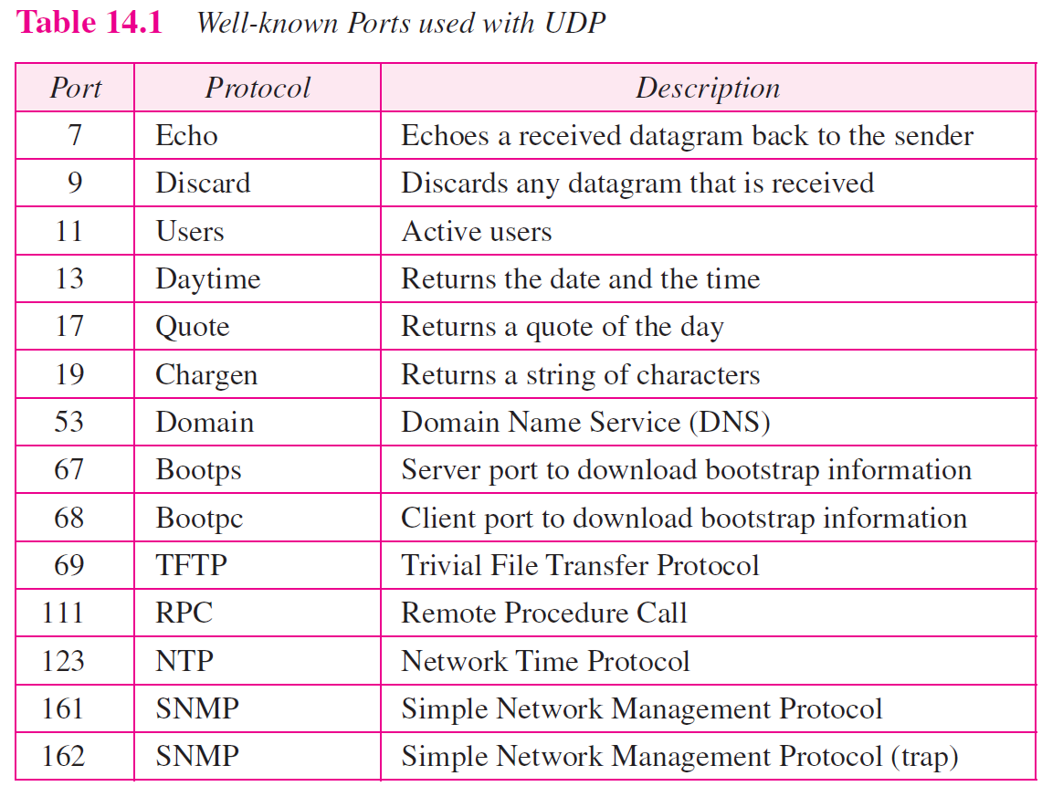
Process-to-Process Communication
By using sockets, a combination of IP addresses and port numbers

Slide 15
Connectionless Services
Each user datagram is an independent datagram
Even coming from the same source process
The user datagram is not numbered
No connection establishment and no connection termination

Slide 16
Connectionless Services (Cont.)
Besides,
The process that uses UDP cannot send a stream of data to UDP
UDP will not chop (切) them into different user datagrams
Thus,
Each application data must be small enough (smaller than 65507) to fit into one user datagram
65507 = 65536 – 8 bytes UDP header – 20 bytes IP header

Slide 17
Flow Control
No flow control
The receiver may overflow with incoming messages

Slide 18
Error Control
No error control except for the checksum
The sender does not know if a message has been lost or duplicated

Slide 19
Checksum
UDP checksum calculation is different from the one for IP and ICMP
The checksum includes three sections
The Pseudoheader
However, it will not appear in the UDP datagram
The UDP header
The data: coming from the application layer

Slide 20
Pseudoheader
Some part of the header of the IP packet with some fields are filled with 0s
Fields
Source and destination IP address
To prevent that UDP datagram is correct but IP header is corrupted and be delivered to the wrong host
Protocol
To prevent the packet to deliver to the TCP
UDP has the value of 17

Slide 21
Pseudoheader (Cont.)
At the time TCP was created (1976),
There was significant concern that there might not be proper “end-to-end” checking of the delivery of datagrams at the IP level
Guarantee end-to-end encrypted TCP semantics
Consider SA, DA…should be shared between IP/TCP, UDP
However, in the context of today's high-speed, highly-reliable networks
The use of the pseudo header sometimes seems unnecessary

Slide 22
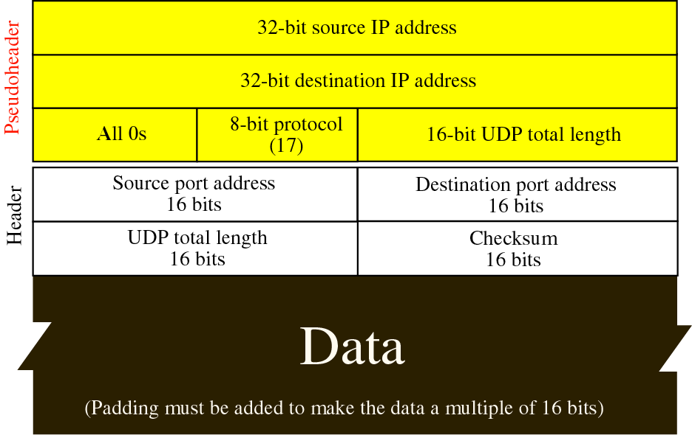
Pseudoheader Added to the UDP Datagram

Slide 23
Checksum Calculation at Sender
Add the pseudoheader to the UDP datagram
Fill the checksum field with zeros
Divide the total bits into 16-bits words
If the total number of bytes is not even
Add 1 byte of padding (all 0s)
Add all 16-bit section using one’s complement arithmetic
Complement the result and insert it in the checksum field
Drop the pesudoheader and any added padding
Deliver the UDP datagram to the IP software

Slide 24
Checksum Calculation at Receiver
Add the pseudoheader to the UDP user datagram
Add padding if needed
Divide the total bits into 16-bit sections
Add all 16-bit sections using one’s complement arithmetic
Complement the result
If the result is all 0s
Drop the pseudoheader and any added padding
Accept the user datagram
Otherwise
Discard the user datagram

Slide 25
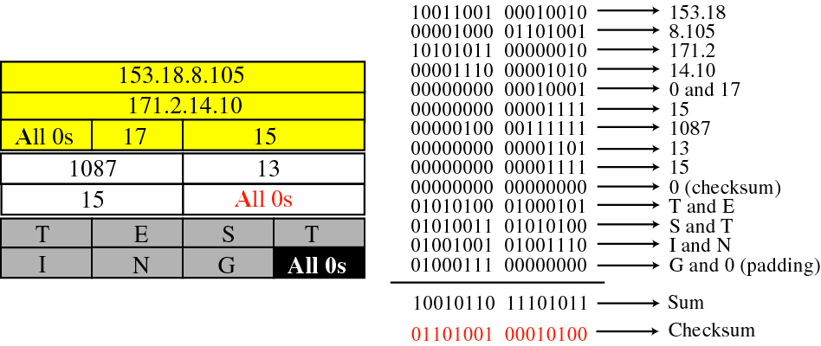
Example 14.2: Checksum Calculation of a simple
UDP User Datagram

Slide 26
Optional Use of the Checksum
The calculation of the checksum in UDP is optional
If the checksum is not calculated
The field is filled with 0s
However, if the checksum happens to be all 0s
To avoid confusion shown above
The checksum is changed to all 1s
Note that, checksum is never all 1s
If checksum is all 1s=> the sum is all 0s=>All fields are 0s
Impossible!

Slide 27
Example 14.3
What value is sent for the checksum in one of the following hypothetical situations?
a. The sender decides not to include the checksum.
b. The sender decides to include the checksum, but the value of the sum is all 1s.
c. The sender decides to include the checksum, but the value of the sum is all 0s.

Slide 28
Example 14.3 Continued
Solution
a. The value sent for the checksum field is all 0s to show that the checksum is not calculated.
b. When the sender complements the sum, the result is all 0s; the sender complements the result again before sending. The value sent for the checksum is all 1s. The second complement operation is needed to avoid confusion with the case in part a.
c. This situation never happens because it implies that the value of every term included in the calculation of the sum is all 0s, which is impossible; some fields in the pseudoheader have nonzero values (see Appendix D).

Slide 29
Congestion Control
Does not provide congestion control
UDP assumes that the packet are small and sporadic
Cannot create congestion in the network
However, may not true today
When UDP is used for video/audio transfer

Slide 30
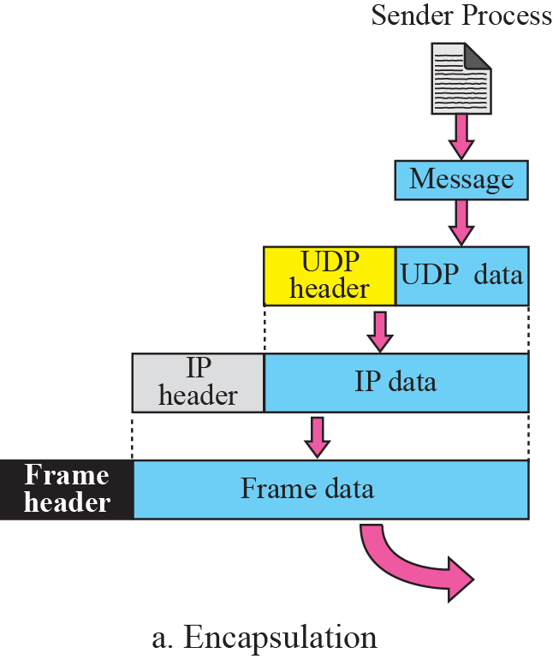
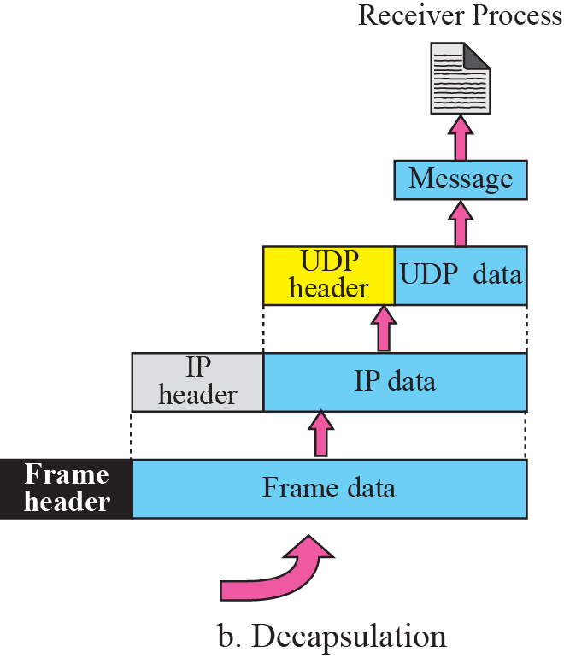

Figure 11-10
Encapsulation and Decapsulation
The McGraw-Hill Companies, Inc., 2000

Slide 31
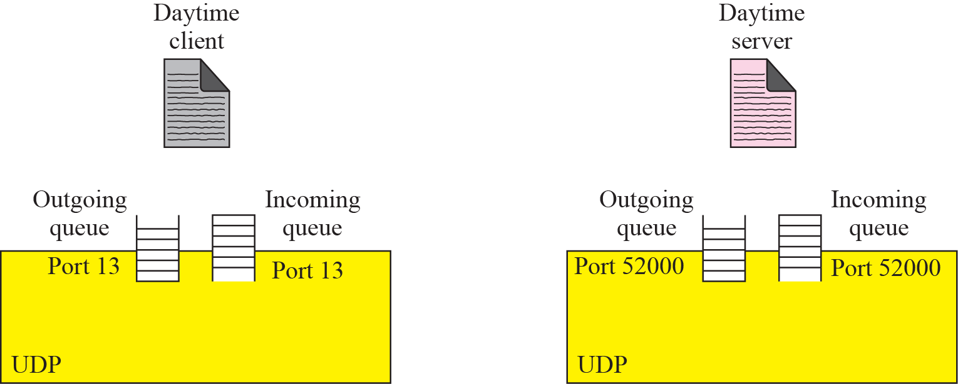
Figure 11-11
Queues in UDP
The McGraw-Hill Companies, Inc., 2000

Slide 32
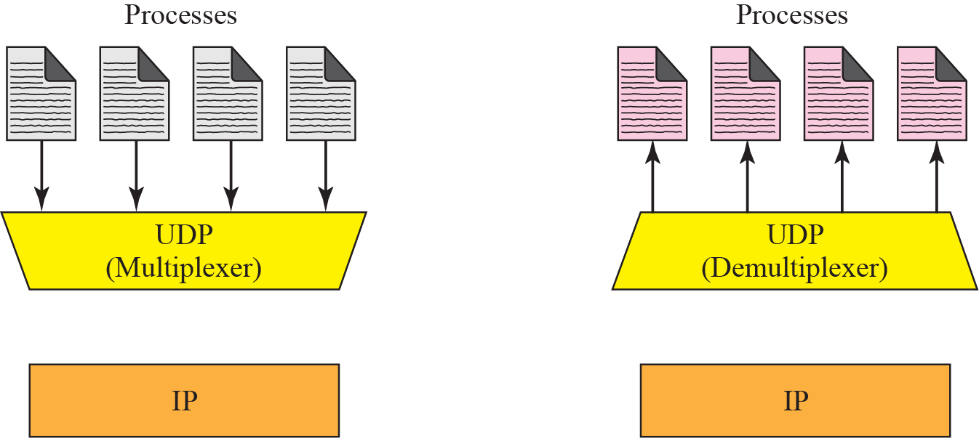
Figure 11-12
Multiplexing and Demultiplexing
The McGraw-Hill Companies, Inc., 2000

Slide 33
Outline
Introduction
User datagram
UDP Services
UDP Applications
UDP package

Slide 34
UDP Applications
Every services has its advantages and disadvantages
Depends on the applications
UDP Features
Connectionless Services
Lack of Error Control
Lack of Congestion Control

Slide 35
UDP Features: Connectionless Services
Connectionless Services is good
If a client needs to send a short request to a server and to receive a short response
Assume that the request and response can fit into one single user datagram
Only needs two packets
However, if using connection-oriented services
Needs at least 9 packets in TCP (shown later)

Slide 36
Example 14.4
DNS uses UDP
A client needs to send a short request to a server and to receive a quick response from it
The request and response can each fit in one user datagram
Thus, only one message is exchanged in each direction
Connectionless feature is not an issue
Do not need to worry that messages are delivered out of order

Slide 37
Example 14.5
SMTP, which is used in electronic mail, cannot use UDP
User may send a long e-mail message, including multimedia data
If uses UDP
The message does not fit in one single user datagram
The message must be split by application into different user datagrams
The user datagrams may arrive and be delivered to the receiver application out of order
Thus, connectionless service has a disadvantage when message is long

Slide 38
UDP Features: Lack of Error Control
If using reliable services
When a part of message is lost or corrupted, it needs to be resent
Cause an uneven delay between different parts of the message

Slide 39
Example 14.6
Assume we download a very large text file
Definitely to use a transport layer that provides reliable service
We don’t want part of the file to be missing or corrupted
The delay between the delivery of the parts are not an concern
Just wait
In this case, UDP is not a suitable transport layer

Slide 40
Example 14.7
Assume we are watching a real-time stream video
If the transport layer is supposed to resend a corrupted or lost frame
Useless or may cause a very long break until the missing frame arrives
If using UDP
The receiving UDP can ignore the corrupted or lost packet
However, video cannot be viewed out of order
So, UDP must reorder or drop frames that are out of sequence.

Slide 41
UDP Features: Lack of Congestion Control
UDP does not create additional traffic in network
However, TCP needs acknowledgment packet and may resend a packet
Create additional traffic

Slide 42
Typical Applications
For a process that require simple request-response communication with little concern for flow and error control
For a process with internal flow and error-control
TFTP (Trivial File Transfer Protocol)
For muticasting and broadcasting
Embedded in UDP but not in the TCP software
For some management processes
For some route updating protocol
RIP (Routing Information Protocol)
For real-time application that cannot tolerate uneven delay

Slide 43
Outline
Introduction
User datagram
UDP Services
UDP Applications
UDP package (Skip!)

